Slide 1
Business Intelligence
Overview

Slide 2
What is Business Intelligence ?.

Slide 3
What is Business Intelligence
Business Intelligence Tools help to gather, access and analyze corporate data to aid in decision-making.
Generally these systems will illustrate business intelligence in the areas of
    Customer Support
    Market Research
    Market Segmentation
    Product Profitability
    Statistical Analysis
    Inventory and Distribution Analysis

Slide 4
Why we Need BI platform ?.
Question

Slide 5
Strategical Analysis

Slide 6
What is the Usage Evolution of Business Intelligence ?.
Question

Slide 7
BI Usage Evolution
STAGE 1
REPORTING
WHAT
happened?
STAGE 2
ANALYZING
WHY
did it happen?
STAGE 3
PREDICTING
WHY
will it happen?
STAGE 4
OPERATIONALIZING
WHAT
IS Happening?
STAGE 5
ACTIVE WAREHOUSING
MAKING
it happen!
Primarily Batch
Increase in Ad Hoc Queries
Analytical Modeling
Continuous Update &
Time Sensitive Queries Become Important
Event Based Triggering
Takes Hold
Batch
Ad Hoc
Analytics
Continuous Update Short Queries
Event-Based Triggering

Slide 8
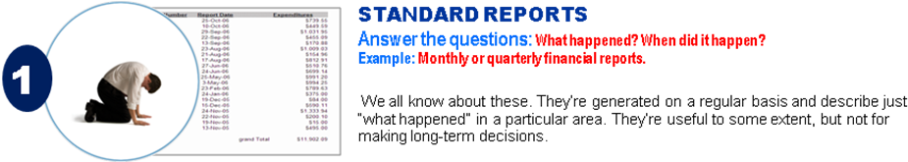
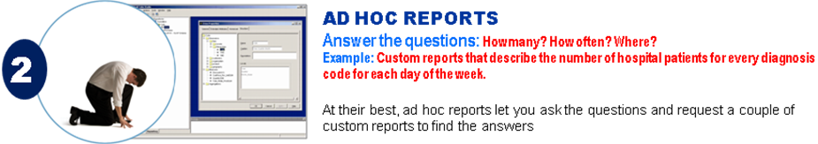
How BI and BA done Technically

Slide 9
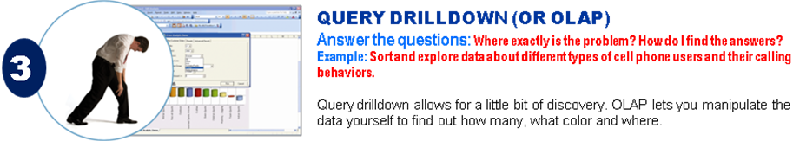
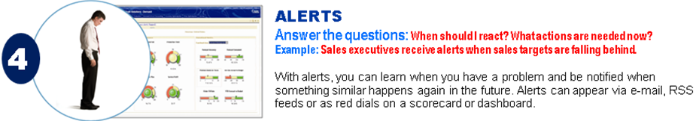
How BI and BA done Technically

Slide 10
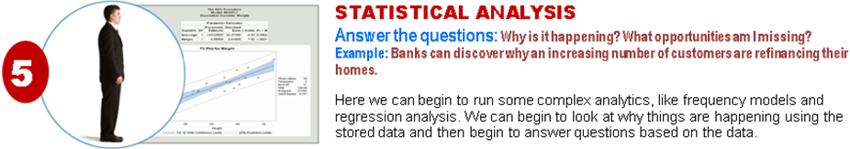
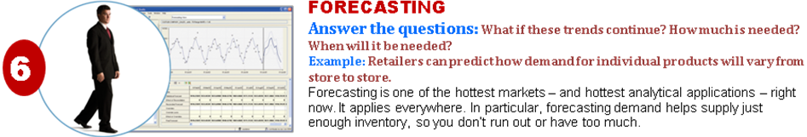
How BI and BA done Technically

Slide 11
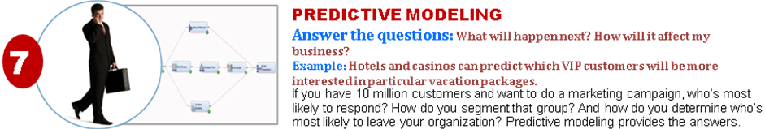
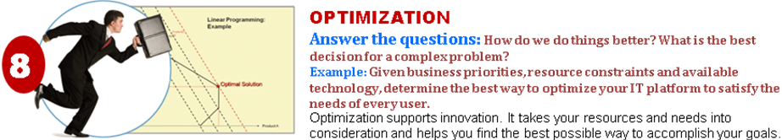
How BI and BA done Technically

Slide 12
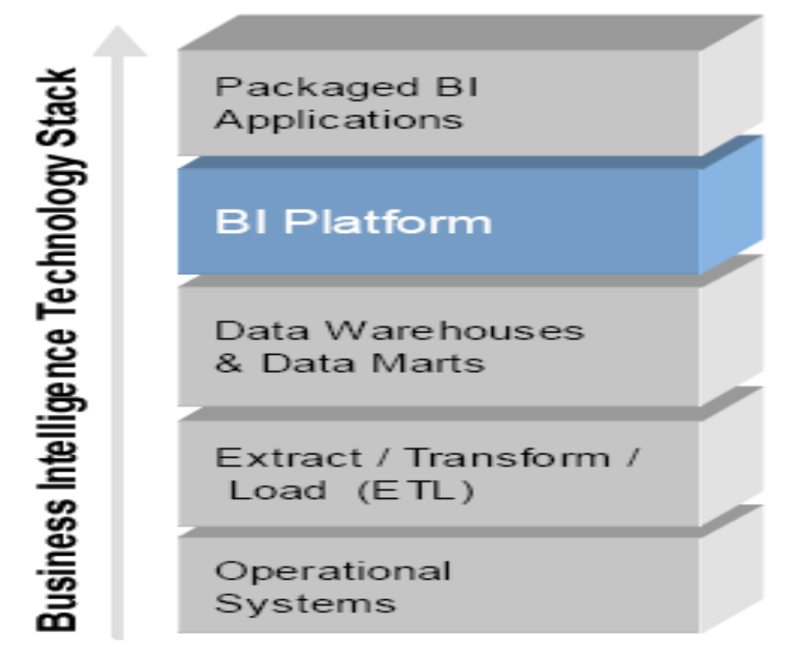
BI Framework

Slide 13
BI Tool Should Deliver 5 Styles of Reporting

Slide 14
Deliver All 5 Styles of BI Reporting
  Enterprise Reporting
  ADHOC Reporting
  OLAP Analysis ( Cube Analysis)
  Performance Management (Scorecards and Dashboards )
  Alerts and Proactive Notification ( Event Based Reporting )

Slide 15
Popular Business Intelligence Tools
Business Objects
Cognos
Hyperion
Microstrategy
Microsoft Reporting Services
Informatica Power Analyzer
Brio

Slide 16
What is OLAP ?.
Question

Slide 17
Why we need OLAP ?.
Question

Slide 18
OLAP Analysis
Organization require to Analyse the Sales Performance by following ways
  Year , Quarter,Month,Week wise Sales Revenue,Quantity sold.
  Franchise Wise Sales Revenue, Quantity Sold, Margin
  Account Wise Sales Revenue, Quantity Sold, Margin
  Department Wise Sales Revenue, Quantity Sold, Margin
  Product wise Sales Revenue, Quantity Sold, Margin
  Item Wise Sales Revenue, Quantity Sold, Margin
  Billtype Wise Sales Revenue, Quantity Sold, Margin
  Account and Product wise Sales Revenue, Quantity Sold, Margin

Slide 19
What do mean by ANALAYTICAL PROCESSING
Question

Slide 20
What do you mean by Analytic Processing ?.
Top Ten Account made REVENUE last Year Quarter wise ?. ( RANKING ).
Cumulative and Running Sales of Product for the Last Month ?. ( Cumulative, Moving Sum )
Why the Sales has gone Down for Last Quarter ?
    ( You have to Drill Down to Detail data and Find out the Cause of Down Fall in Sales )
Trend Analysis for Next Product Promotion in Market ?.
Fraud Analysis For Banking ?.
    Analyse the Buying Patterns
    Analyze the Spending Patterns

Slide 21
OLAP Types
ROLAP
ROLAP stands for Relational Online Analytical Process that provides multidimensional analysis of data, stored in a Relational database (RDBMS).
MOLAP
MOLAP (Multidimensional OLAP), provides the analysis of data stored in a multi-dimensional data cube.
HOLAP
HOLAP(Hybrid OLAP) a combination of both ROLAP and MOLAP can provide multidimensional analysis simultaneously of data stored in a multidimensional database and in a relational database (RDBMS).
DOLAP
DOLAP (Desktop OLAP or Database OLAP) provide multidimensional analysis locally in the client machine on the data collected from relational or multidimensional database servers.

Slide 22
Performance Management Reporting

Slide 23
Scorecards and Dashboard

Slide 24
DASHBOARD Reports

Slide 25
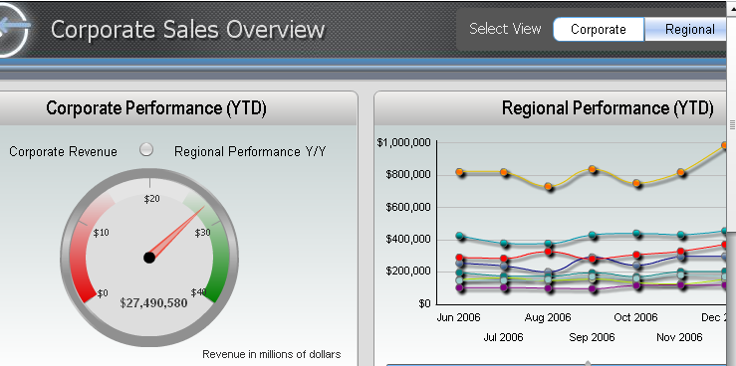
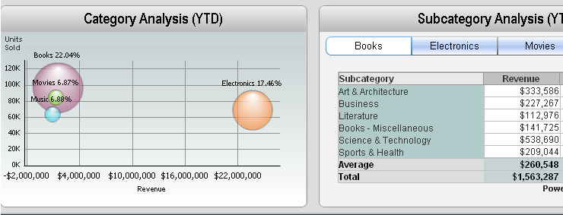

Slide 26
Scorecards

Slide 27
Scorecards
What is a Scorecard?
A Scorecard provides a way for business users to track and improve corporate performance by presenting key performance indicators (KPIs) — or strategic metrics — with current, target, and historic results in a visual record.

Slide 28
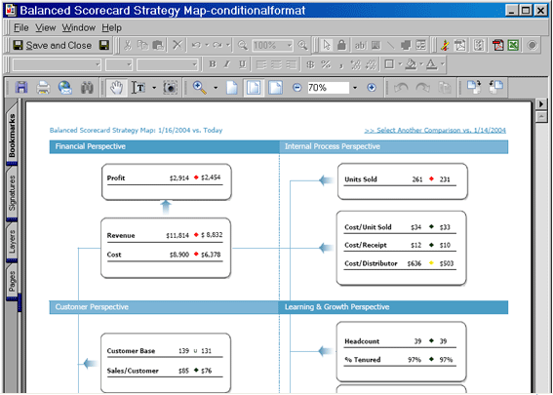

Slide 29
Report Form – Managed Metrics Reports for business unit leaders:

Slide 30
